Slide 1


SQL Part 9

Slide 2
JOIN
JOIN is used to combine rows from two or more tables based on a related column between them.
This allows you to retrieve data from multiple tables in a single query.

Slide 3
Types of Joins
INNER JOIN
Retrieves records that have matching values in both tables.

Slide 4
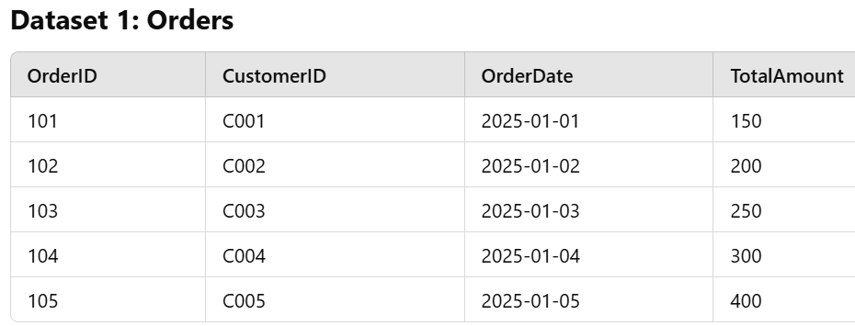
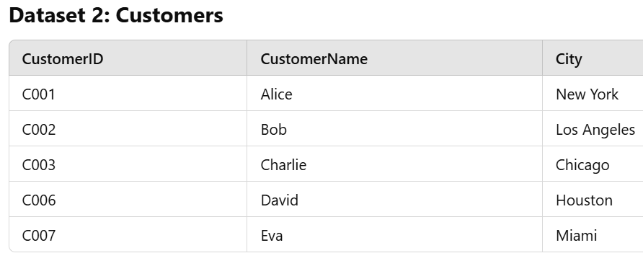

Slide 5
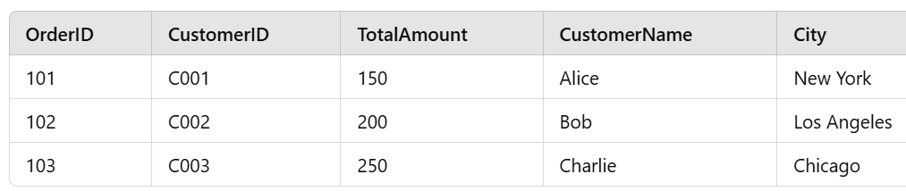
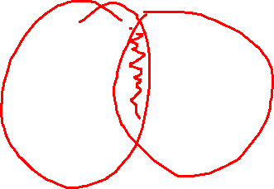

Slide 6
2. LEFT JOIN
Retrieves all records from the left table and the matched records from the right table.

Slide 7


Slide 8
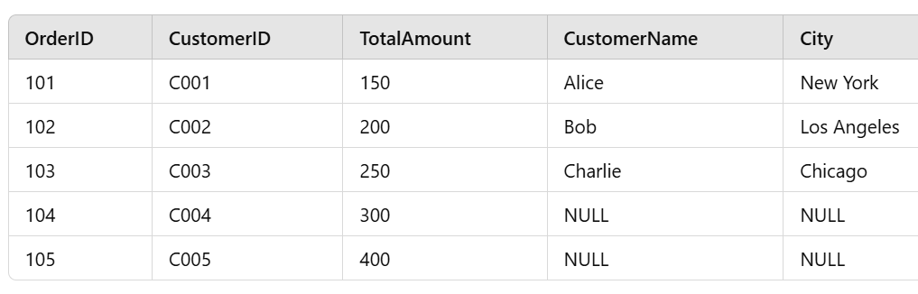

Slide 9
3. RIGHT JOIN
Retrieves all records from the right table and the matched records from the left table.

Slide 10


Slide 11
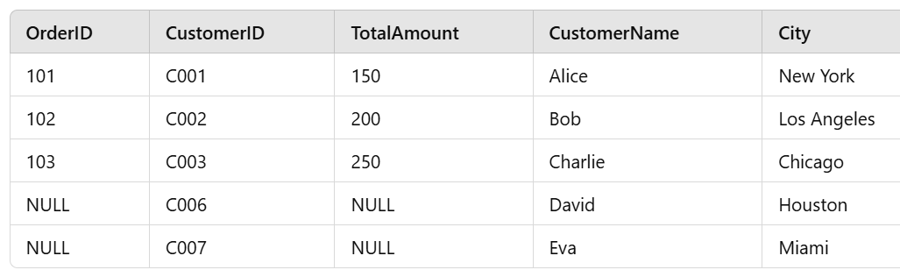


Slide 12
4. FULL JOIN
Retrieves all records when there is a match in either the left or the right table.

Slide 13


Slide 14
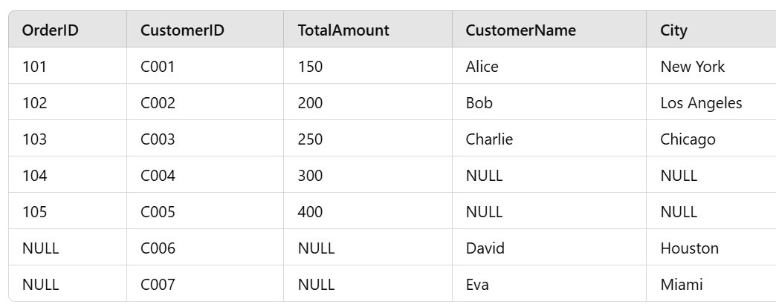


Slide 15
5. CROSS JOIN
Produces the Cartesian product of the two tables, combining every row from the first table with every row from the second table.
A
B
1
2
3

Slide 18
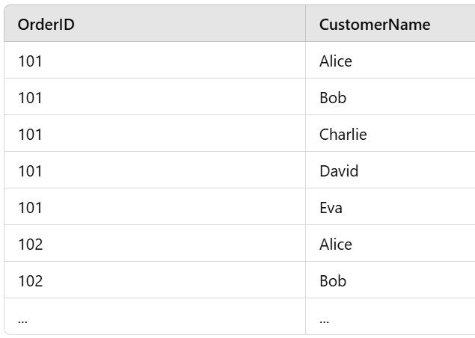

Slide 19
6. SELF JOIN Joins a table with itself.

Slide 20
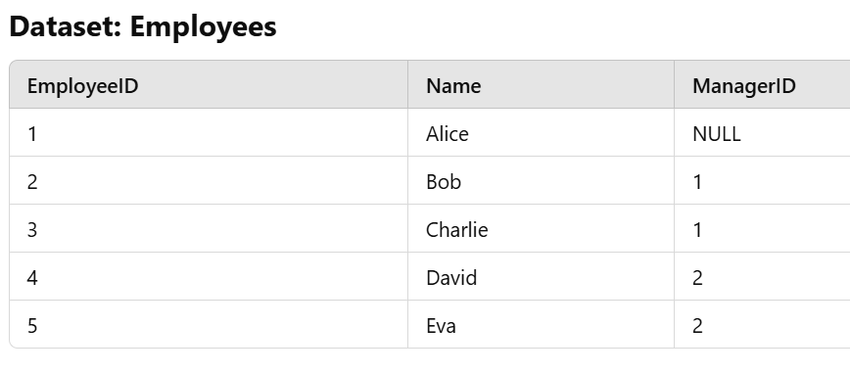

Slide 21
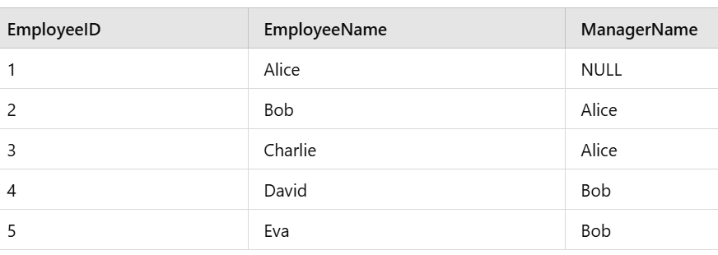
Problem: Find the employees and their corresponding managers' names.

Slide 22
Problems
Retrieve the details of orders along with the customer name and city for customers who have placed orders.
Retrieve all orders and include customer details (name and city), if available.
Retrieve all customers and include their order details, if available.
Retrieve all orders and customers, whether they match or not.
Generate all possible combinations of orders and customers.
Find all orders placed by the same customer

Slide 23
SQL Set Operators
Set operators in SQL are used to combine the results of two or more SELECT queries, ensuring the combination of rows based on certain conditions.
There are four main types of set operators in SQL:
UNION {1,2,3}, {4,5,1} = {1,2,3,4,5}
UNION ALL {1,1,2,3,4,5}
INTERSECT {1}
EXCEPT (or MINUS in some databases) {2,3}

Slide 24
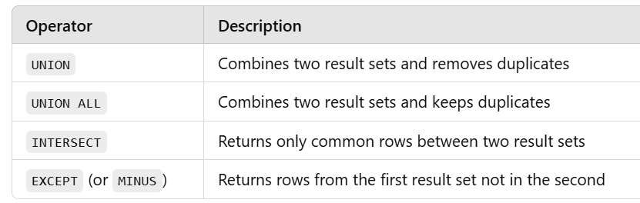

Slide 25
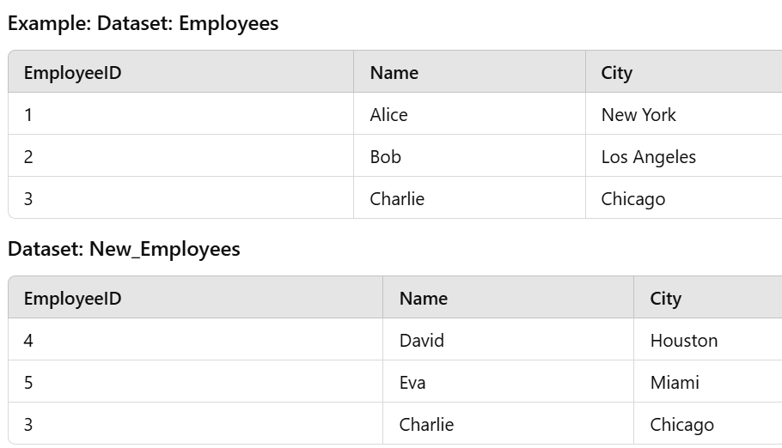

Slide 26
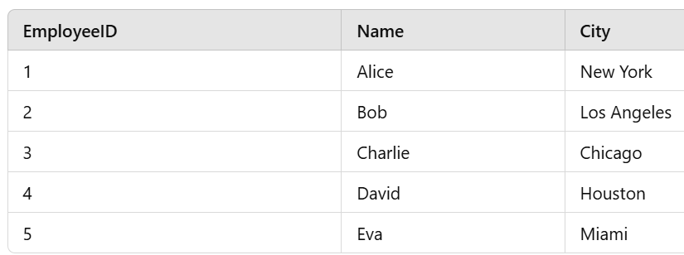
UNION

Slide 27
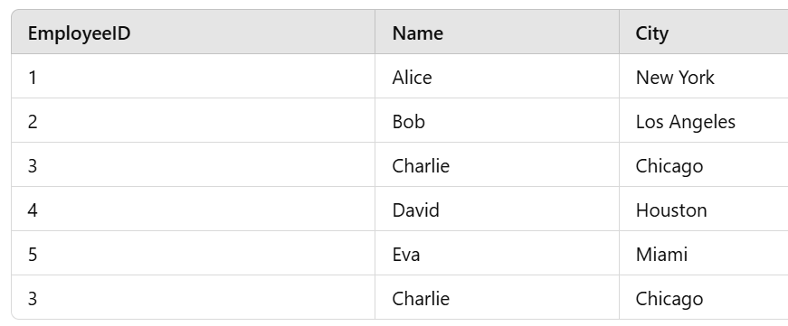
2. UNION ALL

Slide 28
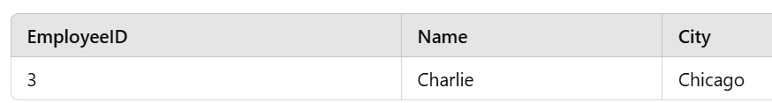
3. INTERSECT

Slide 29
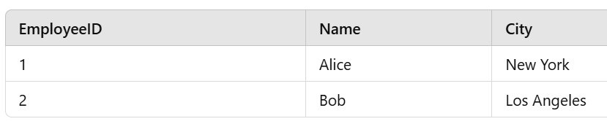
EXCEPT (or MINUS)

Slide 30

Thank you

